Slide 1
C++ is Fun – Part 17 at Turbine/Warner Bros.!
Russell Hanson

Slide 2
Syllabus
1) First program and introduction to data types and control structures with applications for games learning how to use the programming environment Mar 25-27
2) Objects, encapsulation, abstract data types, data protection and scope April 1-3
3) Basic data structures and how to use them, opening files and performing operations on files – April 8-10
4) Algorithms on data structures, algorithms for specific tasks, simple AI and planning type algorithms, game AI algorithms April 15-17
Project 1 Due – April 17
5) More AI: search, heuristics, optimization, decision trees, supervised/unsupervised learning – April 22-24
6) Game API and/or event-oriented programming, model view controller, map reduce filter – April 29, May 1
7) Basic threads models and some simple databases SQLite May 6-8
8) Graphics programming, shaders, textures, 3D models and rotations May 13-15
Project 2 Due May 15
9) Threads, Atomic, and Exceptions, more May 20
10) Gesture recognition & depth controllers like the Microsoft Kinect, Network Programming & TCP/IP, OSC May 27
11) Selected Topics June 3
12) Working on student projects - June 10
Final project presentations Project 3/Final Project Due June 10

Slide 3
Cinder, Open FrameWorks, and OSC!

Slide 4
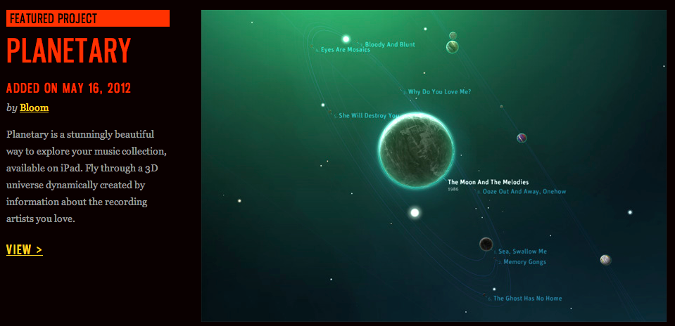

Slide 5
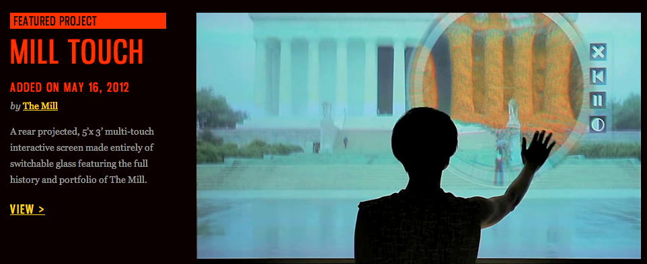

Slide 6
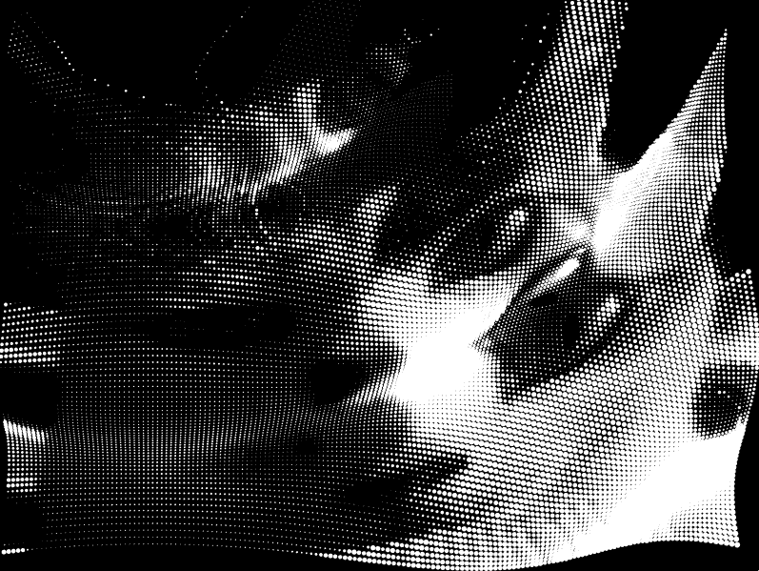

Slide 7
What was that?! ^^
Source code in:
“17. Cinder, OSC, Open Frameworks/
Ch 3 Particle Tutorial src”
#include "cinder/app/AppBasic.h"
#include "cinder/Rand.h"
#include "cinder/Vector.h"
#include "ParticleController.h"
using namespace ci;
using std::list;
ParticleController::ParticleController(){}
ParticleController::ParticleController( int res )
{
mXRes = app::getWindowWidth()/res;
mYRes = app::getWindowHeight()/res;
for( int y=0; y<mYRes; y++ ){
for( int x=0; x<mXRes; x++ ){
addParticle( x, y, res );
}
}
}
void ParticleController::update( const Channel32f &channel, const Vec2i &mouseLoc )
{
for( list<Particle>::iterator p = mParticles.begin(); p != mParticles.end(); ++p ){
p->update( channel, mouseLoc );
}
}
void ParticleController::draw()
{
for( list<Particle>::iterator p = mParticles.begin(); p != mParticles.end(); ++p ){
p->draw();
}
}
void ParticleController::addParticle( int xi, int yi, int res )
{
float x = ( xi + 0.5f ) * (float)res;
float y = ( yi + 0.5f ) * (float)res;
mParticles.push_back( Particle( Vec2f( x, y ) ) );
}
void ParticleController::addParticles( int amt )
{
for( int i=0; i<amt; i++ )
{
float x = Rand::randFloat( app::getWindowWidth() );
float y = Rand::randFloat( app::getWindowHeight() );
mParticles.push_back( Particle( Vec2f( x, y ) ) );
}
}
void ParticleController::removeParticles( int amt )
{
for( int i=0; i<amt; i++ ){
mParticles.pop_back();
}
}

Slide 8
#include "Particle.h"
#include "cinder/Rand.h"
#include "cinder/gl/gl.h"
#include "cinder/app/AppBasic.h"
using namespace ci;
Particle::Particle()
{
}
Particle::Particle( Vec2f loc )
{
mLoc = loc;
mDir = Rand::randVec2f();
mDirToCursor = Vec2f::zero();
mVel = 0.0f;
mRadius = 0.0f;
mScale = 3.0f;
}
void Particle::update( const Channel32f &channel, const Vec2i &mouseLoc )
{
mDirToCursor = mouseLoc - mLoc;
float distToCursor = mDirToCursor.length();
float time = app::getElapsedSeconds();
float dist = distToCursor * 0.025f;
float sinOffset = sin( dist - time ) + 1.0f;
mDirToCursor.normalize();
mDirToCursor *= sinOffset * 100.0f;
Vec2f newLoc = mLoc + mDirToCursor;
newLoc.x = constrain( newLoc.x, 0.0f, channel.getWidth() - 1.0f );
newLoc.y = constrain( newLoc.y, 0.0f, channel.getHeight() - 1.0f );
mRadius = channel.getValue( newLoc ) * mScale;
}
void Particle::draw()
{
//gl::color( Color( 1.0f, 1.0f, 1.0f ) );
//gl::drawVector( Vec3f( mLoc, 0.0f ), Vec3f( mLoc + mDirToCursor * 15.0f, 0.0f ), 6.0f, 3.0f );
gl::drawSolidCircle( mLoc + mDirToCursor * 0.2f, mRadius );
}

Slide 9
#include "cinder/app/AppBasic.h"
#include "cinder/ImageIO.h"
#include "cinder/gl/Texture.h"
#include "cinder/Channel.h"
#include "cinder/Vector.h"
#include "ParticleController.h"
// RESOLUTION refers to the number of pixels
// between neighboring particles. If you increase
// RESOULTION to 10, there will be 1/4th as many particles.
// Setting RESOLUTION to 1 will create 1 particle for
// every pixel in the app window.
#define RESOLUTION 5
using namespace ci;
using namespace ci::app;
class TutorialApp : public AppBasic {
public:
void prepareSettings( Settings *settings );
void keyDown( KeyEvent event );
void mouseMove( MouseEvent event );
void mouseDrag( MouseEvent event );
void setup();
void update();
void draw();
Channel32f mChannel;
gl::Texture mTexture;
Vec2i mMouseLoc;
ParticleController mParticleController;
bool mDrawParticles;
bool mDrawImage;
};
void TutorialApp::prepareSettings( Settings *settings )
{
settings->setWindowSize( 800, 600 );
settings->setFrameRate( 60.0f );
}
void TutorialApp::mouseMove( MouseEvent event )
{
mMouseLoc = event.getPos();
}
void TutorialApp::mouseDrag( MouseEvent event )
{
mouseMove( event );
}
void TutorialApp::keyDown( KeyEvent event )
{
if( event.getChar() == '1' ){
mDrawImage = ! mDrawImage;
} else if( event.getChar() == '2' ){
mDrawParticles = ! mDrawParticles;
}
}
void TutorialApp::setup()
{
Url url( "http://libcinder.org/media/tutorial/paris.jpg" );
mChannel = Channel32f( loadImage( loadUrl( url ) ) );
mTexture = mChannel;
mParticleController = ParticleController( RESOLUTION );
mMouseLoc = Vec2i( 0, 0 );
mDrawParticles = true;
mDrawImage = false;
}
void TutorialApp::update()
{
if( ! mChannel ) return;
mParticleController.update( mChannel, mMouseLoc );
}
void TutorialApp::draw()
{
gl::clear( Color( 0, 0, 0 ), true );
if( mDrawImage ){
mTexture.enableAndBind();
gl::draw( mTexture, getWindowBounds() );
}
if( mDrawParticles ){
glDisable( GL_TEXTURE_2D );
mParticleController.draw();
}
}
CINDER_APP_BASIC( TutorialApp, RendererGl )

Slide 10
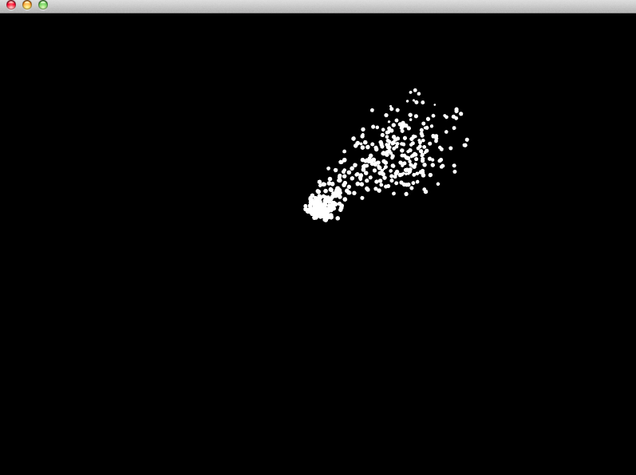
Source code in:
“17. Cinder, OSC, Open Frameworks/
Ch 4 src”

Slide 11
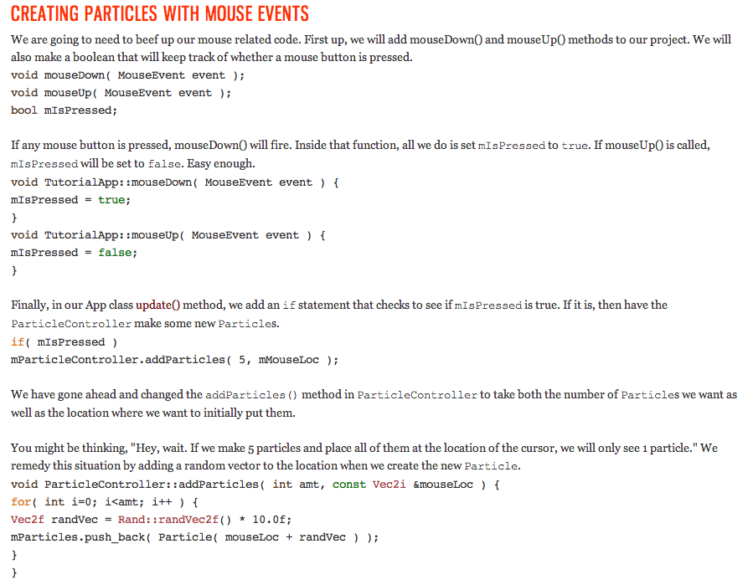

Slide 12
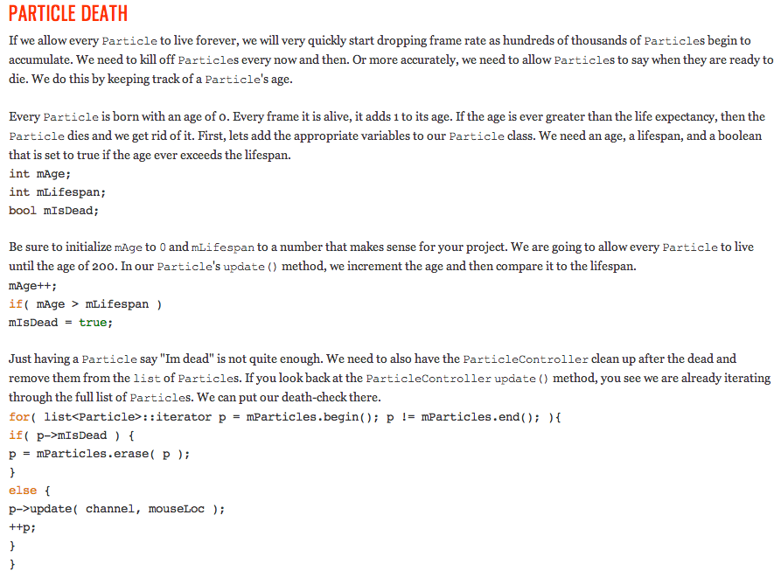

Slide 13
Want a job doing C++? Better know some keywords and be able to talk about them
Job Title: C++ Application Integration
^{Job Description:}
The Job Description is as follows:
­­>Application Integration(L3)­
­­>Batch Processing(L3)­Candidate skills include: Design of batch scripts and jobs Analysis of batch scripts and jobs Monitoring and Trouble shooting
­­>Unix Application Programming(L4)­Networking Protocols, Advanced signal handling( concept of signal masks,signal sets, POSIX signal handling, race conditions etc ), Timers, resource limits, Unix debugging and tracing features Advanced unix user space commands (archival/restore, SCM, cron etc) Concept of threads, multithreading, advanced i/o, file and record locking Advanced system design, Knowledge of unix variants, porting considerations etc Performance tuning and optimization
­­>C++(L2)­Should be working in a C++ Project. Should be aware of the following concepts in C++ 1) Pointers, references, arrays, temporaries, lvalue, rvalue 2)Polymorphism, static/dynamic binding, pure virtual functions & abstract class3) Operator overloading, function overloading, default arguments, friend functions 4) C++I/O, C++ File I/O, Stream manipulators 5) Able to convert a problem statement into pseudo code / algorithm and implement the same in C++.
­­>C++(L3)­Should be working in a C++ Project. Should be aware of the
following concepts in C++ 1) Basics of Exception Handling 2) Namespaces, dynamic_cast, static_cast, const_cast, typeid & RTTI 3) C++ Containers, String Class, Basics of algorithms & iterators, Basics of Function objects
4) Template functions and classes, Basics of: Template Parameters, Restrictions on type parameters, template argument deduction, explicit and implicit instantiation, typename keyword 5) Class template specialization, default template arguments, Partial Specialization 6) Template Compilation Models, Inclusion model, Separation Model 7) Function templates overloading, function template specialization 8) smart pointers / auto_ptr 9) Data Structures and Memory management in C++, different flavors of operator new 10) Familiarity with development and debugging on a particular platform using appropriate tools 11) Familiarity with static analysis tools like DeepCheck, ^{C++ test etc.}
­­>Application Testing(L3)­Should be able to differentiate the different testing phases like Unit Integration, System, Acceptance, Regression testing and should be capable to perform these tests with the help of ready­test cases. Should understand Test Plans, Requirement Traceability Matrix, Orthogonal Array Tool. Should be able to do metrics analysis and reliability analysis effectively with DFA tool.
Education: Bachelors Degree Experience
^{Level : 5­8 YEAR}

Slide 14
View:
osc openFrameworks application-a92q-Qw22f4.mp4

Slide 15
/*
Copyright (c) 2010, Hector Sanchez-Pajares
Aer Studio http://www.aerstudio.com
All rights reserved.
This is a block for OSC Integration for Cinder framework developed by The Barbarian Group, 2010
Redistribution and use in source and binary forms, with or without modification, are permitted provided that
the following conditions are met:
* Redistributions of source code must retain the above copyright notice, this list of conditions and
the following disclaimer.
* Redistributions in binary form must reproduce the above copyright notice, this list of conditions and
the following disclaimer in the documentation and/or other materials provided with the distribution.
THIS SOFTWARE IS PROVIDED BY THE COPYRIGHT HOLDERS AND CONTRIBUTORS "AS IS" AND ANY EXPRESS OR IMPLIED
WARRANTIES, INCLUDING, BUT NOT LIMITED TO, THE IMPLIED WARRANTIES OF MERCHANTABILITY AND FITNESS FOR A
PARTICULAR PURPOSE ARE DISCLAIMED. IN NO EVENT SHALL THE COPYRIGHT HOLDER OR CONTRIBUTORS BE LIABLE FOR
ANY DIRECT, INDIRECT, INCIDENTAL, SPECIAL, EXEMPLARY, OR CONSEQUENTIAL DAMAGES (INCLUDING, BUT NOT LIMITED
TO, PROCUREMENT OF SUBSTITUTE GOODS OR SERVICES; LOSS OF USE, DATA, OR PROFITS; OR BUSINESS INTERRUPTION)
HOWEVER CAUSED AND ON ANY THEORY OF LIABILITY, WHETHER IN CONTRACT, STRICT LIABILITY, OR TORT (INCLUDING
NEGLIGENCE OR OTHERWISE) ARISING IN ANY WAY OUT OF THE USE OF THIS SOFTWARE, EVEN IF ADVISED OF THE
POSSIBILITY OF SUCH DAMAGE.
*/
/*
Based on addon ofxOsc for openFrameworks
by Damian Stewart
http://addons.openframeworks.cc/projects/show/ofxosc
http://frey.co.nz/old/projects/ofxosc/
*/
#include "cinder/app/AppNative.h"
#include "cinder/System.h"
#include "OscSender.h"
using namespace ci;
using namespace ci::app;
using namespace std;
class OSCSenderApp : public AppNative {
public:
void setup();
void update();
void draw();
void mouseMove( MouseEvent event );
void mouseDrag( MouseEvent event );
int mMouseLocX;
osc::Sender sender;
float positionX;
std::string host;
int port;
};
void OSCSenderApp::setup()
{
mMouseLocX = getWindowCenter().x;
port = 3000;
// assume the broadcast address is this machine's IP address but with 255 as the final value
// so to multicast from IP 192.168.1.100, the host should be 192.168.1.255
host = System::getIpAddress();
if( host.rfind( '.' ) != string::npos )
host.replace( host.rfind( '.' ) + 1, 3, "255" );
sender.setup( host, port, true );
}
void OSCSenderApp::update()
{
float freq = mMouseLocX / (float)getWindowWidth() * 10.0f;
positionX = cos(freq * getElapsedSeconds()) / 2.0f + .5f;
osc::Message message;
message.addFloatArg(positionX);
message.setAddress("/cinder/osc/1");
message.setRemoteEndpoint(host, port);
sender.sendMessage(message);
}
void OSCSenderApp::mouseMove( MouseEvent event )
{
mMouseLocX = event.getX();
}
void OSCSenderApp::mouseDrag( MouseEvent event )
{
mouseMove(event);
}
void OSCSenderApp::draw()
{
gl::clear();
gl::color( Color::gray( 0.5f ) );
gl::drawSolidRect(Rectf(Vec2f(0, 0), Vec2f(positionX * getWindowWidth(), getWindowHeight())));
}
CINDER_APP_NATIVE( OSCSenderApp, RendererGl )
In the Google Drive:
OSCSenderApp.cpp

Slide 16
#include "cinder/app/AppNative.h"
using namespace ci;
using namespace ci::app;
#include "OscListener.h"
class OSCListenerApp : public AppNative {
public:
void setup();
void update();
void draw();
osc::Listener listener;
float positionX;
};
void OSCListenerApp::setup()
{
listener.setup( 3000 );
positionX = 0;
}
void OSCListenerApp::update()
{
while( listener.hasWaitingMessages() ) {
osc::Message message;
listener.getNextMessage( &message );
console() << "New message received" << std::endl;
console() << "Address: " << message.getAddress() << std::endl;
console() << "Num Arg: " << message.getNumArgs() << std::endl;
for (int i = 0; i < message.getNumArgs(); i++) {
console() << "-- Argument " << i << std::endl;
console() << "---- type: " << message.getArgTypeName(i) << std::endl;
if( message.getArgType(i) == osc::TYPE_INT32 ) {
try {
console() << "------ value: "<< message.getArgAsInt32(i) << std::endl;
}
catch (...) {
console() << "Exception reading argument as int32" << std::endl;
}
}
else if( message.getArgType(i) == osc::TYPE_FLOAT ) {
try {
console() << "------ value: " << message.getArgAsFloat(i) << std::endl;
}
catch (...) {
console() << "Exception reading argument as float" << std::endl;
}
}
else if( message.getArgType(i) == osc::TYPE_STRING) {
try {
console() << "------ value: " << message.getArgAsString(i).c_str() << std::endl;
}
catch (...) {
console() << "Exception reading argument as string" << std::endl;
}
}
}
if( message.getNumArgs() != 0 && message.getArgType( 0 ) == osc::TYPE_FLOAT )
positionX = message.getArgAsFloat(0);
}
}
void OSCListenerApp::draw()
{
gl::clear();
gl::color( Color::white() );
gl::drawSolidRect( Rectf(Vec2f(0, 0), Vec2f(positionX * getWindowWidth(), getWindowHeight())) );
}
CINDER_APP_NATIVE( OSCListenerApp, RendererGl )
In the Google Drive:
OSCListenerApp.cpp

Slide 17
More topics in Cinder!
SECTION TWO: FLOCKING SIMULATION
Chapter 1: Camera and Parameters
We will learn about the Cinder Camera class and use it to create a 3D environment for the Particle engine we made in Section One. Then we will show how to setup a Params class for controlling variables during runtime.
Chapter 2: Rule One - Separation
The first rule of flocking is described and implemented. This rule states that all flocking objects should avoid getting too close to each other. This helps to mitigate overcrowding and collisions.
Chapter 3: Rule Two - Cohesion
The second rule is one of attraction. Flocking objects will move towards each other in order to prevent any individual from becoming isolated and exposed.
Chapter 4: Rule Three - Alignment
The third rule is arguably the most important. Alignment, or orientation, states that flocking objects will try to move in the general direction of the nearest neighbors. This inevitably leads to characteristic group behavior that is witnessed in large groups of birds and fish.
Chapter 5: Rule Four - Evasion
In this final chapter, we will add a few predators to the simulation and show how to add personality and behavioral diversity to the flock in order to produce a more organic result.

Slide 18
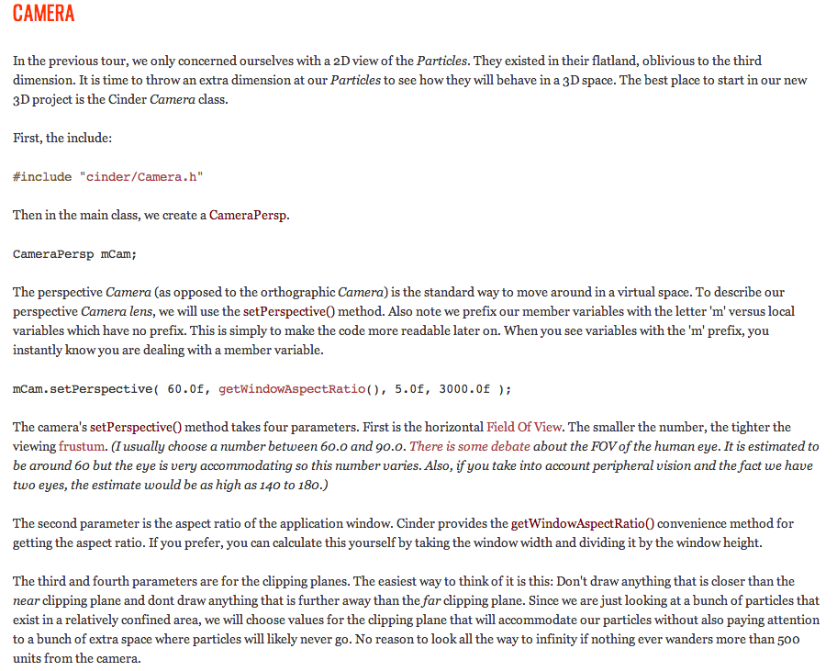

Slide 19
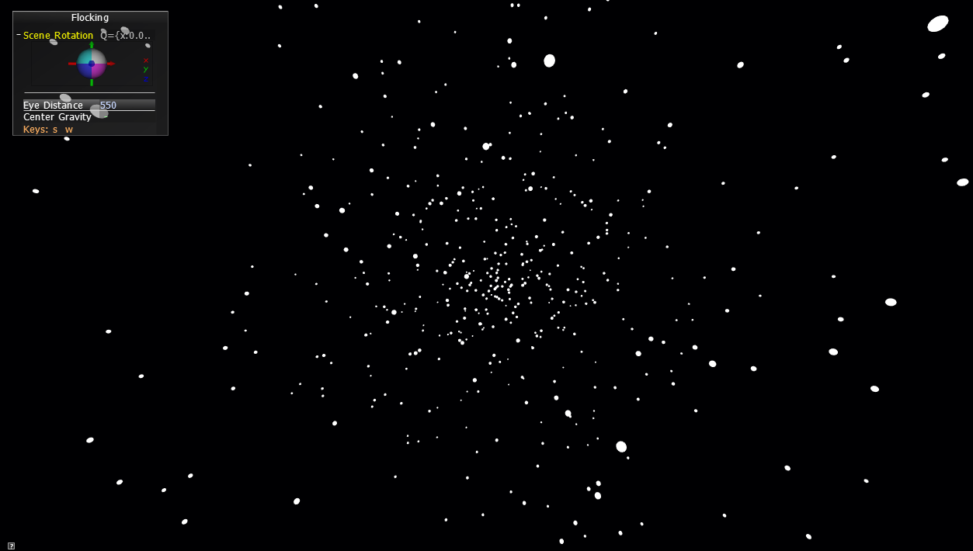

Slide 20
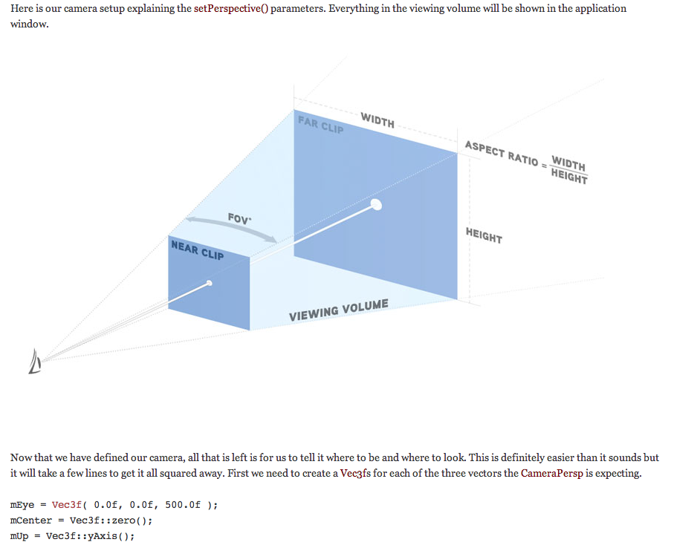

Slide 21
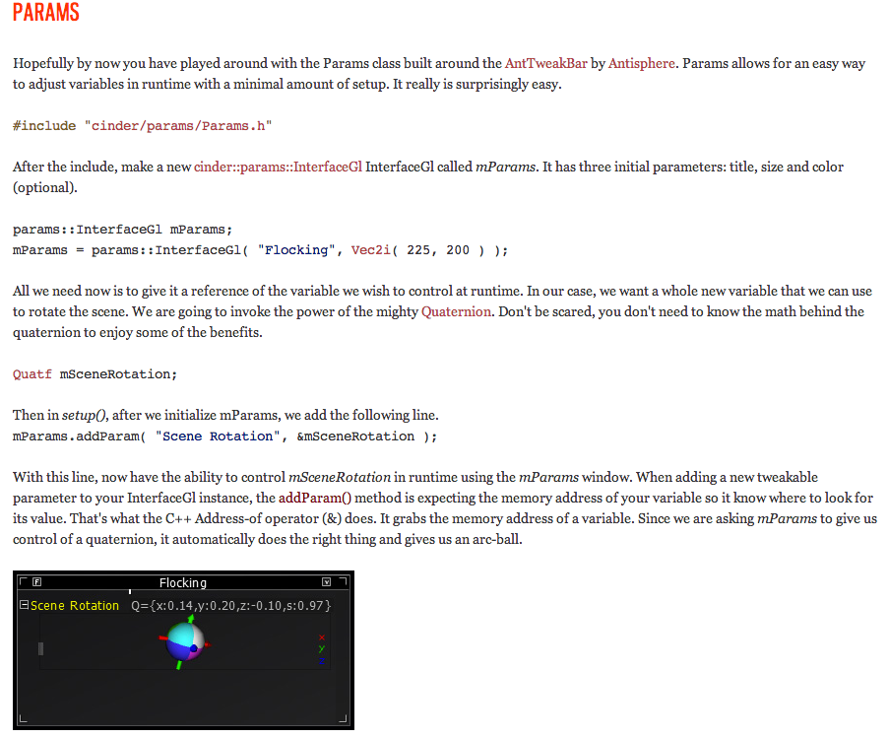

Slide 22
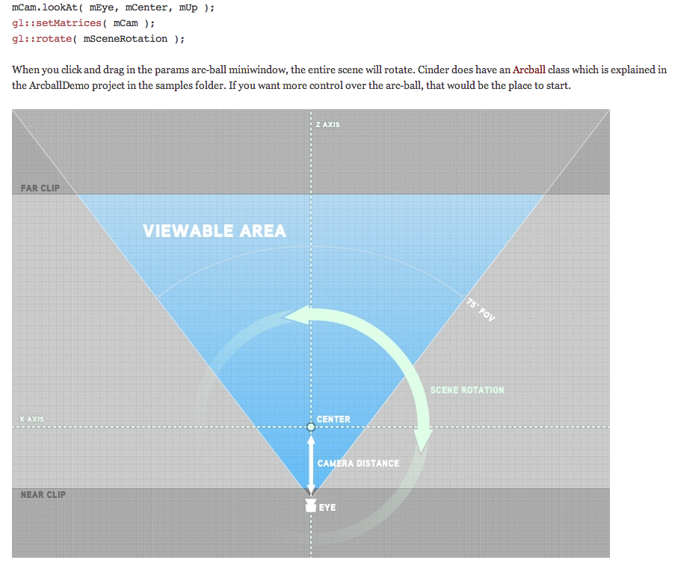

Slide 23
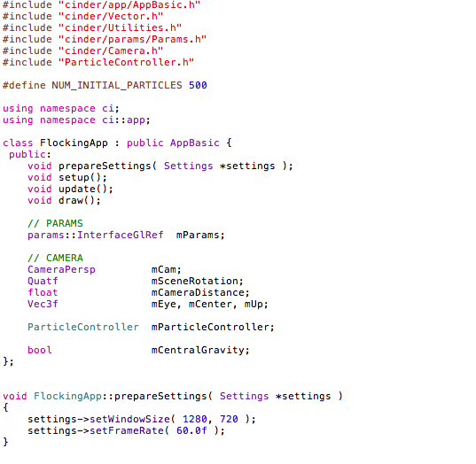

Slide 24
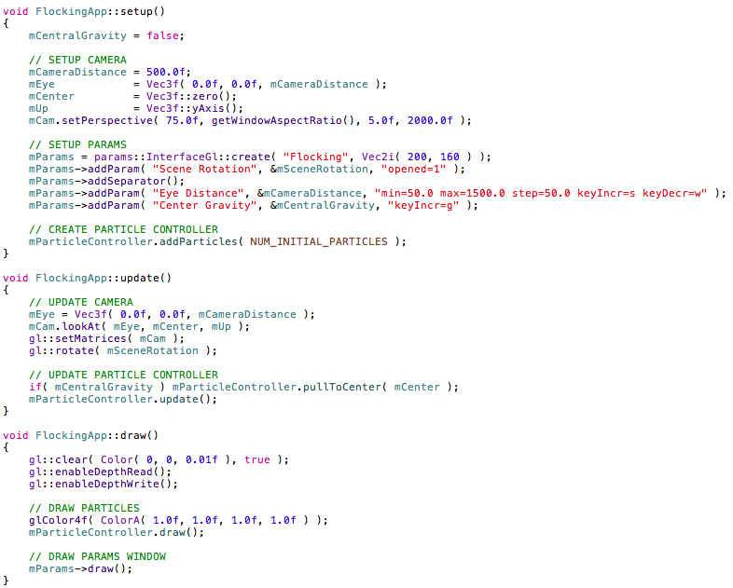

Slide 25
#include "cinder/app/AppBasic.h"
#include "cinder/Rand.h"
#include "cinder/Vector.h"
#include "ParticleController.h"
using namespace ci;
using std::list;
ParticleController::ParticleController()
{
}
void ParticleController::pullToCenter( const ci::Vec3f &center )
{
for( list<Particle>::iterator p = mParticles.begin(); p != mParticles.end(); ++p ) {
p->pullToCenter( center );
}
}
void ParticleController::update()
{
for( list<Particle>::iterator p = mParticles.begin(); p != mParticles.end(); ++p ) {
p->update();
}
}
void ParticleController::draw()
{
for( list<Particle>::iterator p = mParticles.begin(); p != mParticles.end(); ++p ) {
p->draw();
}
}
void ParticleController::addParticles( int amt )
{
for( int i=0; i<amt; i++ ) {
Vec3f randVec = Rand::randVec3f();
Vec3f pos = randVec * Rand::randFloat( 50.0f );
Vec3f vel = randVec * Rand::randFloat( 5.0f );
mParticles.push_back( Particle( pos, vel ) );
}
}

Slide 26
#include "Particle.h"
#include "cinder/Rand.h"
#include "cinder/gl/gl.h"
#include "cinder/app/AppBasic.h"
using namespace ci;
Particle::Particle()
{
}
Particle::Particle( Vec3f pos, Vec3f vel )
{
mPos = pos;
mVel = vel;
mAcc = Vec3f::zero();
mRadius = 2.0f;
mDecay = 0.99f;
}
void Particle::pullToCenter( const Vec3f &center )
{
Vec3f dirToCenter = mPos - center;
float distToCenter = dirToCenter.length();
float maxDistance = 300.0f;
if( distToCenter > maxDistance ){
dirToCenter.normalize();
float pullStrength = 0.0001f;
mVel -= dirToCenter * ( ( distToCenter - maxDistance ) * pullStrength );
}
}
void Particle::update(){
mVel += mAcc;
mPos += mVel;
mVel *= mDecay;
mAcc = Vec3f::zero();
}
void Particle::draw()
{
gl::drawSphere( mPos, mRadius, 16 );
}

Slide 27
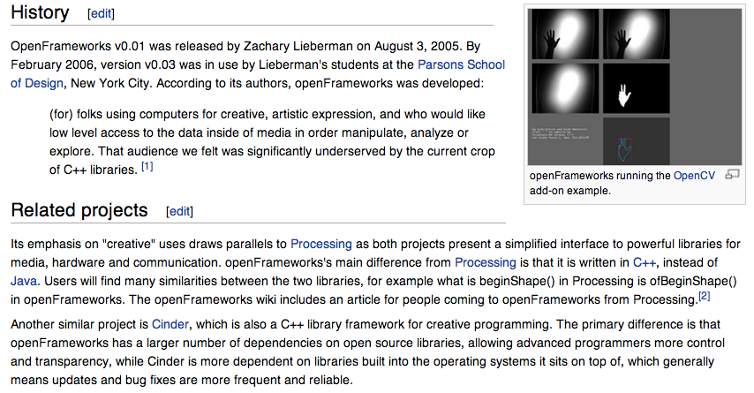
What is open frameworks and why should you care? (Btw wikipedia is useful)

Slide 28
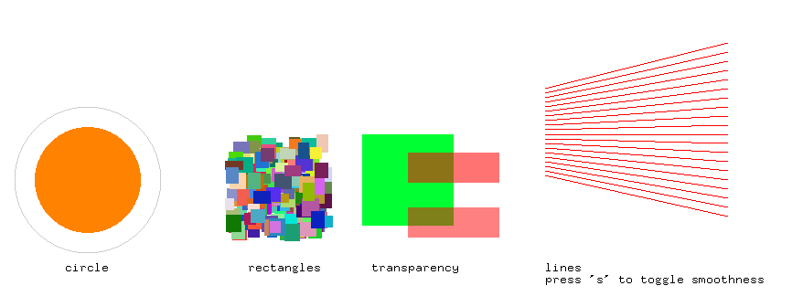

Slide 29
void testApp::setup(){
counter = 0;
ofSetCircleResolution(50);
ofBackground(255,255,255);
bSmooth = false;
ofSetWindowTitle("graphics example");
ofSetFrameRate(60); // if vertical sync is off, we can go a bit fast... this caps the framerate at 60fps.
}
//--------------------------------------------------------------
void testApp::update(){
counter = counter + 0.033f;
}
//--------------------------------------------------------------
void testApp::draw(){
//--------------------------- circles
//let's draw a circle:
ofSetColor(255,130,0);
float radius = 50 + 10 * sin(counter);
ofFill(); // draw "filled shapes"
ofCircle(100,400,radius);
// now just an outline
ofNoFill();
ofSetHexColor(0xCCCCCC);
ofCircle(100,400,80);
// use the bitMap type
// note, this can be slow on some graphics cards
// because it is using glDrawPixels which varies in
// speed from system to system. try using ofTrueTypeFont
// if this bitMap type slows you down.
ofSetHexColor(0x000000);
ofDrawBitmapString("circle", 75,500);
//--------------------------- rectangles
ofFill();
for (int i = 0; i < 200; i++){
ofSetColor((int)ofRandom(0,255),(int)ofRandom(0,255),(int)ofRandom(0,255));
ofRect(ofRandom(250,350),ofRandom(350,450),ofRandom(10,20),ofRandom(10,20));
}
ofSetHexColor(0x000000);
ofDrawBitmapString("rectangles", 275,500);
//--------------------------- transparency
ofSetHexColor(0x00FF33);
ofRect(400,350,100,100);
// alpha is usually turned off - for speed puposes. let's turn it on!
ofEnableAlphaBlending();
ofSetColor(255,0,0,127); // red, 50% transparent
ofRect(450,430,100,33);
ofSetColor(255,0,0,(int)(counter * 10.0f) % 255); // red, variable transparent
ofRect(450,370,100,33);
ofDisableAlphaBlending();
ofSetHexColor(0x000000);
ofDrawBitmapString("transparency", 410,500);
//--------------------------- lines
// a bunch of red lines, make them smooth if the flag is set
if (bSmooth){
ofEnableSmoothing();
}
ofSetHexColor(0xFF0000);
for (int i = 0; i < 20; i++){
ofLine(600,300 + (i*5),800, 250 + (i*10));
}
if (bSmooth){
ofDisableSmoothing();
}
ofSetHexColor(0x000000);
ofDrawBitmapString("lines\npress 's' to toggle smoothness", 600,500);
}
In the Google Drive:
OpenFrameworks Graphics src

Slide 30
Lots of “add ons” included in OpenFrameworks including
Video
PDF
OSC
OpenCV (Computer Vision)
SVG reader
Etc.

Slide 31
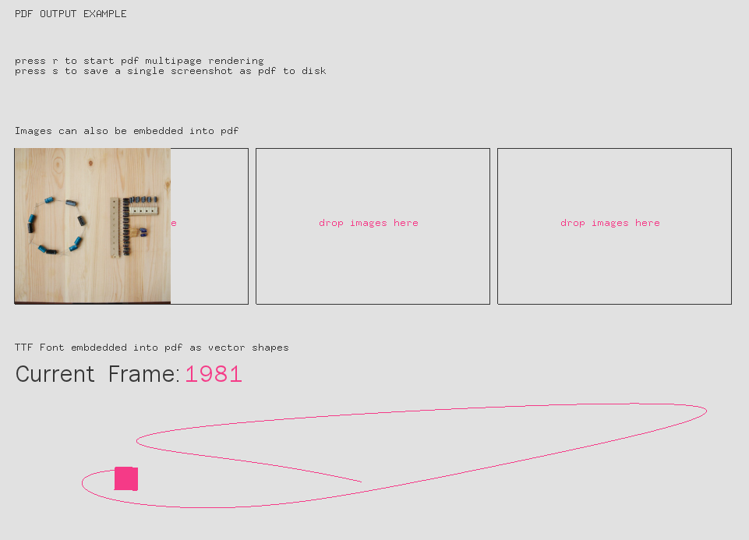

Slide 32
Save Screen as PDF
//--------------------------------------------------------------
void testApp::draw(){
if( oneShot ){
ofBeginSaveScreenAsPDF("screenshot-"+ofGetTimestampString()+".pdf", false);
}
ofSetColor(54);
ofDrawBitmapString("PDF OUTPUT EXAMPLE", 32, 32);
if( pdfRendering ){
ofDrawBitmapString("press r to stop pdf multipage rendering", 32, 92);
}else{
ofDrawBitmapString("press r to start pdf multipage rendering\npress s to save a single screenshot as pdf to disk", 32, 92);
}
ofFill();
ofSetColor(54,54,54);
ofDrawBitmapString("TTF Font embdedded into pdf as vector shapes", 32, 460);
if( oneShot || pdfRendering ){
font.drawStringAsShapes("Current Frame: ", 32, 500);
ofSetColor(245, 58, 135);
font.drawStringAsShapes( ofToString(ofGetFrameNum()), 32 + font.getStringBoundingBox("Current Frame: ", 0, 0).width + 9, 500);
}else{
font.drawString("Current Frame: ", 32, 500);
ofSetColor(245, 58, 135);
font.drawString( ofToString(ofGetFrameNum()), 32 + font.getStringBoundingBox("Current Frame: ", 0, 0).width + 9, 500);
}

Slide 33
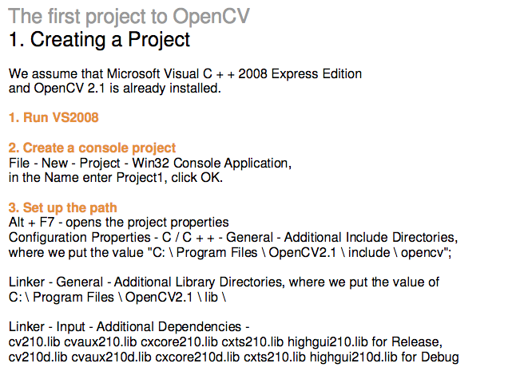

Slide 34
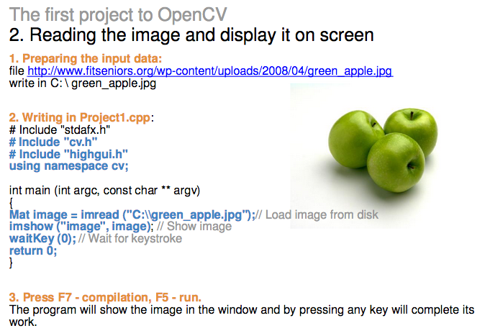

Slide 35
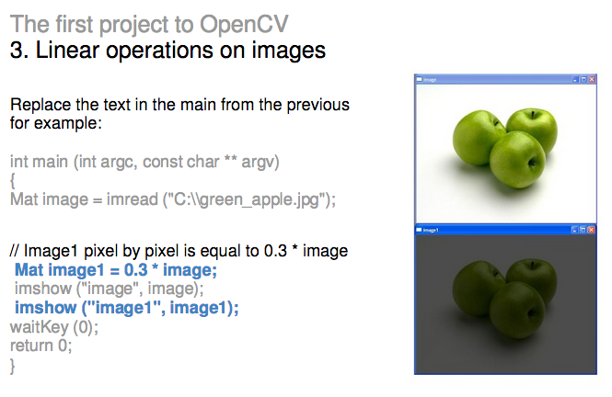

Slide 36
And more add-ons
#include "ofMain.h"
#include "ofxOpenCv.h"
#include "ofxNetwork.h"
#include "ofxOsc.h"
//#include "ofxSynth.h"
#include "ofxXmlSettings.h"
#include "ofx3DModelLoader.h"
#include "ofxAssimpModelLoader.h"
#include "ofxThreadedImageLoader.h"
class testApp : public ofBaseApp{
public:
void setup();
void update();
void draw();
void keyPressed(int key);
void keyReleased(int key);
void mouseMoved(int x, int y );
void mouseDragged(int x, int y, int button);
void mousePressed(int x, int y, int button);
void mouseReleased(int x, int y, int button);
void windowResized(int w, int h);
void dragEvent(ofDragInfo dragInfo);
void gotMessage(ofMessage msg);
// we don't actually use these
// just checking to see if they
// all work in the same place :)
ofxCvGrayscaleImage cvGray;
ofxTCPClient client;
ofxTCPServer server;
ofxOscSender osc_sender;
ofxXmlSettings settings;
ofx3DModelLoader modelLoader;
ofxAssimpModelLoader betterModelLoader;
//ofxSynth synth;
ofxThreadedImageLoader threadedLoader;
};

Slide 37
Syllabus
Final project presentations June 10 at Turbine!
How are things coming together?
*** SNIP ***
10) Gesture recognition & depth controllers like the Microsoft Kinect, Network Programming & TCP/IP, OSC May 27
11) Selected Topics June 3
12) Working on student projects - June 10
Final project presentations Project 3/Final Project Due June 10

